Slide 1
Note Book Security
蘇筱芫 Sara
陳楷仁 Ken
郭晉晏 Ian
鄭力維 Livy

Slide 2



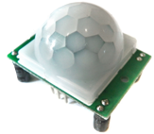

Project Structure
phote
Server
Sockets
Web server / Apeche
NCTU Wireless
phote
Thief
client
filename
JDBC
Waring
filename
Database
Detect motion
Photo display
PIR sensor
client
5V/GND/Pin 8

Slide 3
Source URL : https://goo.gl/VhOQfK
https://drive.google.com/drive/u/1/folders/0B00pakfIqUwKZVNEZFBKNU5vMnM
Photo display :
140.113.73.131:81/arduino/loadExternalData.html
Server IP : 140.113.73.131

Slide 4
Materials
Import four library *.jar
mysql-connector-java-5.1.39-bin.jar
RXTXcomm.jar
webcam-capture-0.3.10.jar
bridj-0.6.2.jar
slf4j-api-1.7.2.jar
Client side
PIR motion sensor
Arduino board + USB cable
Webcam
Eclipse
Server side

Slide 5
Instruction
Upload PIRsensor.ino.
Import three library for Eclipse.
Execute ArduinoTest1.java
Connect Arduino board.

Slide 6
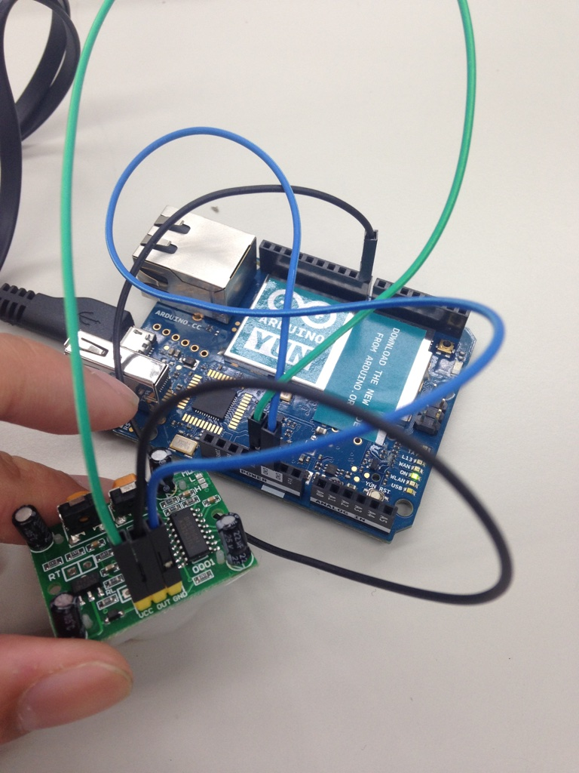
PIR Motion Sensor
Green line>5V
Blue line>GND
Black line>pin 8
Sensor instruction (in Chinese): http://www.pu-yang.com.tw/media/products/0258629001406789125.pdf

Slide 7
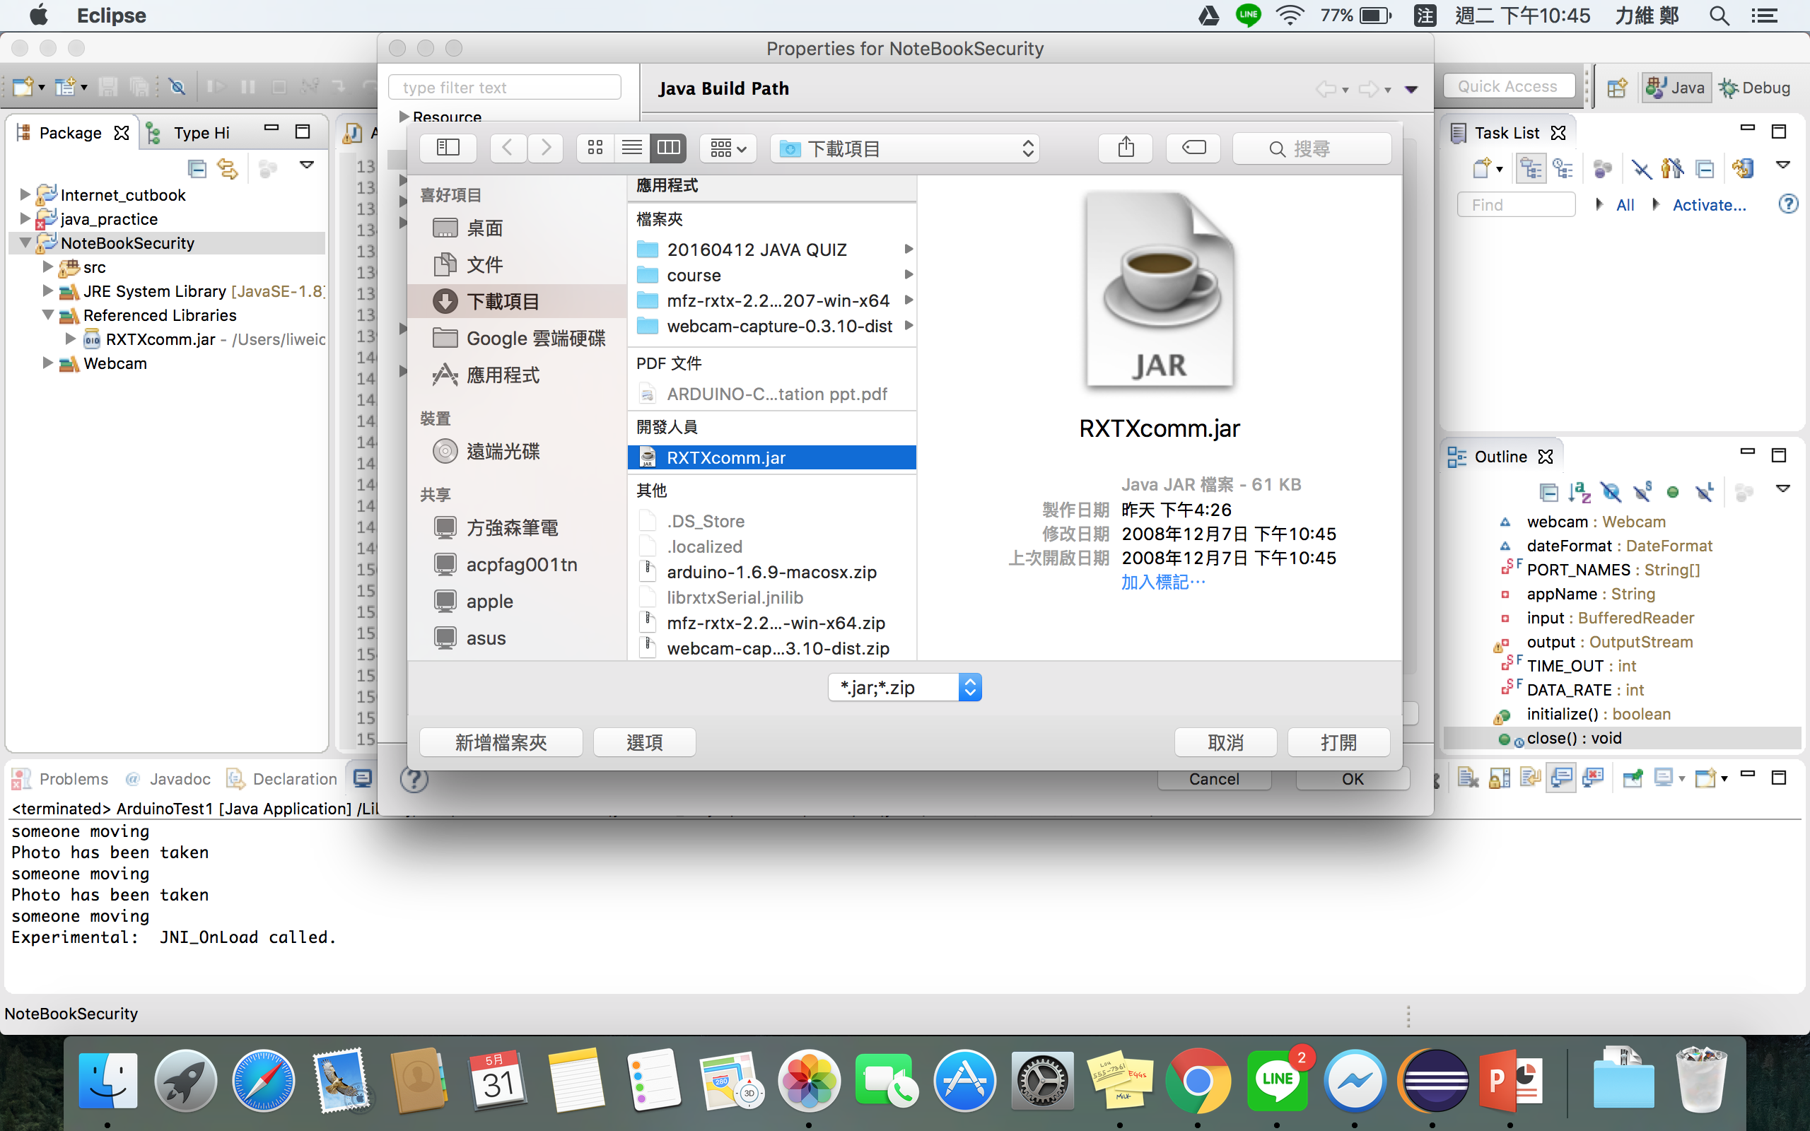
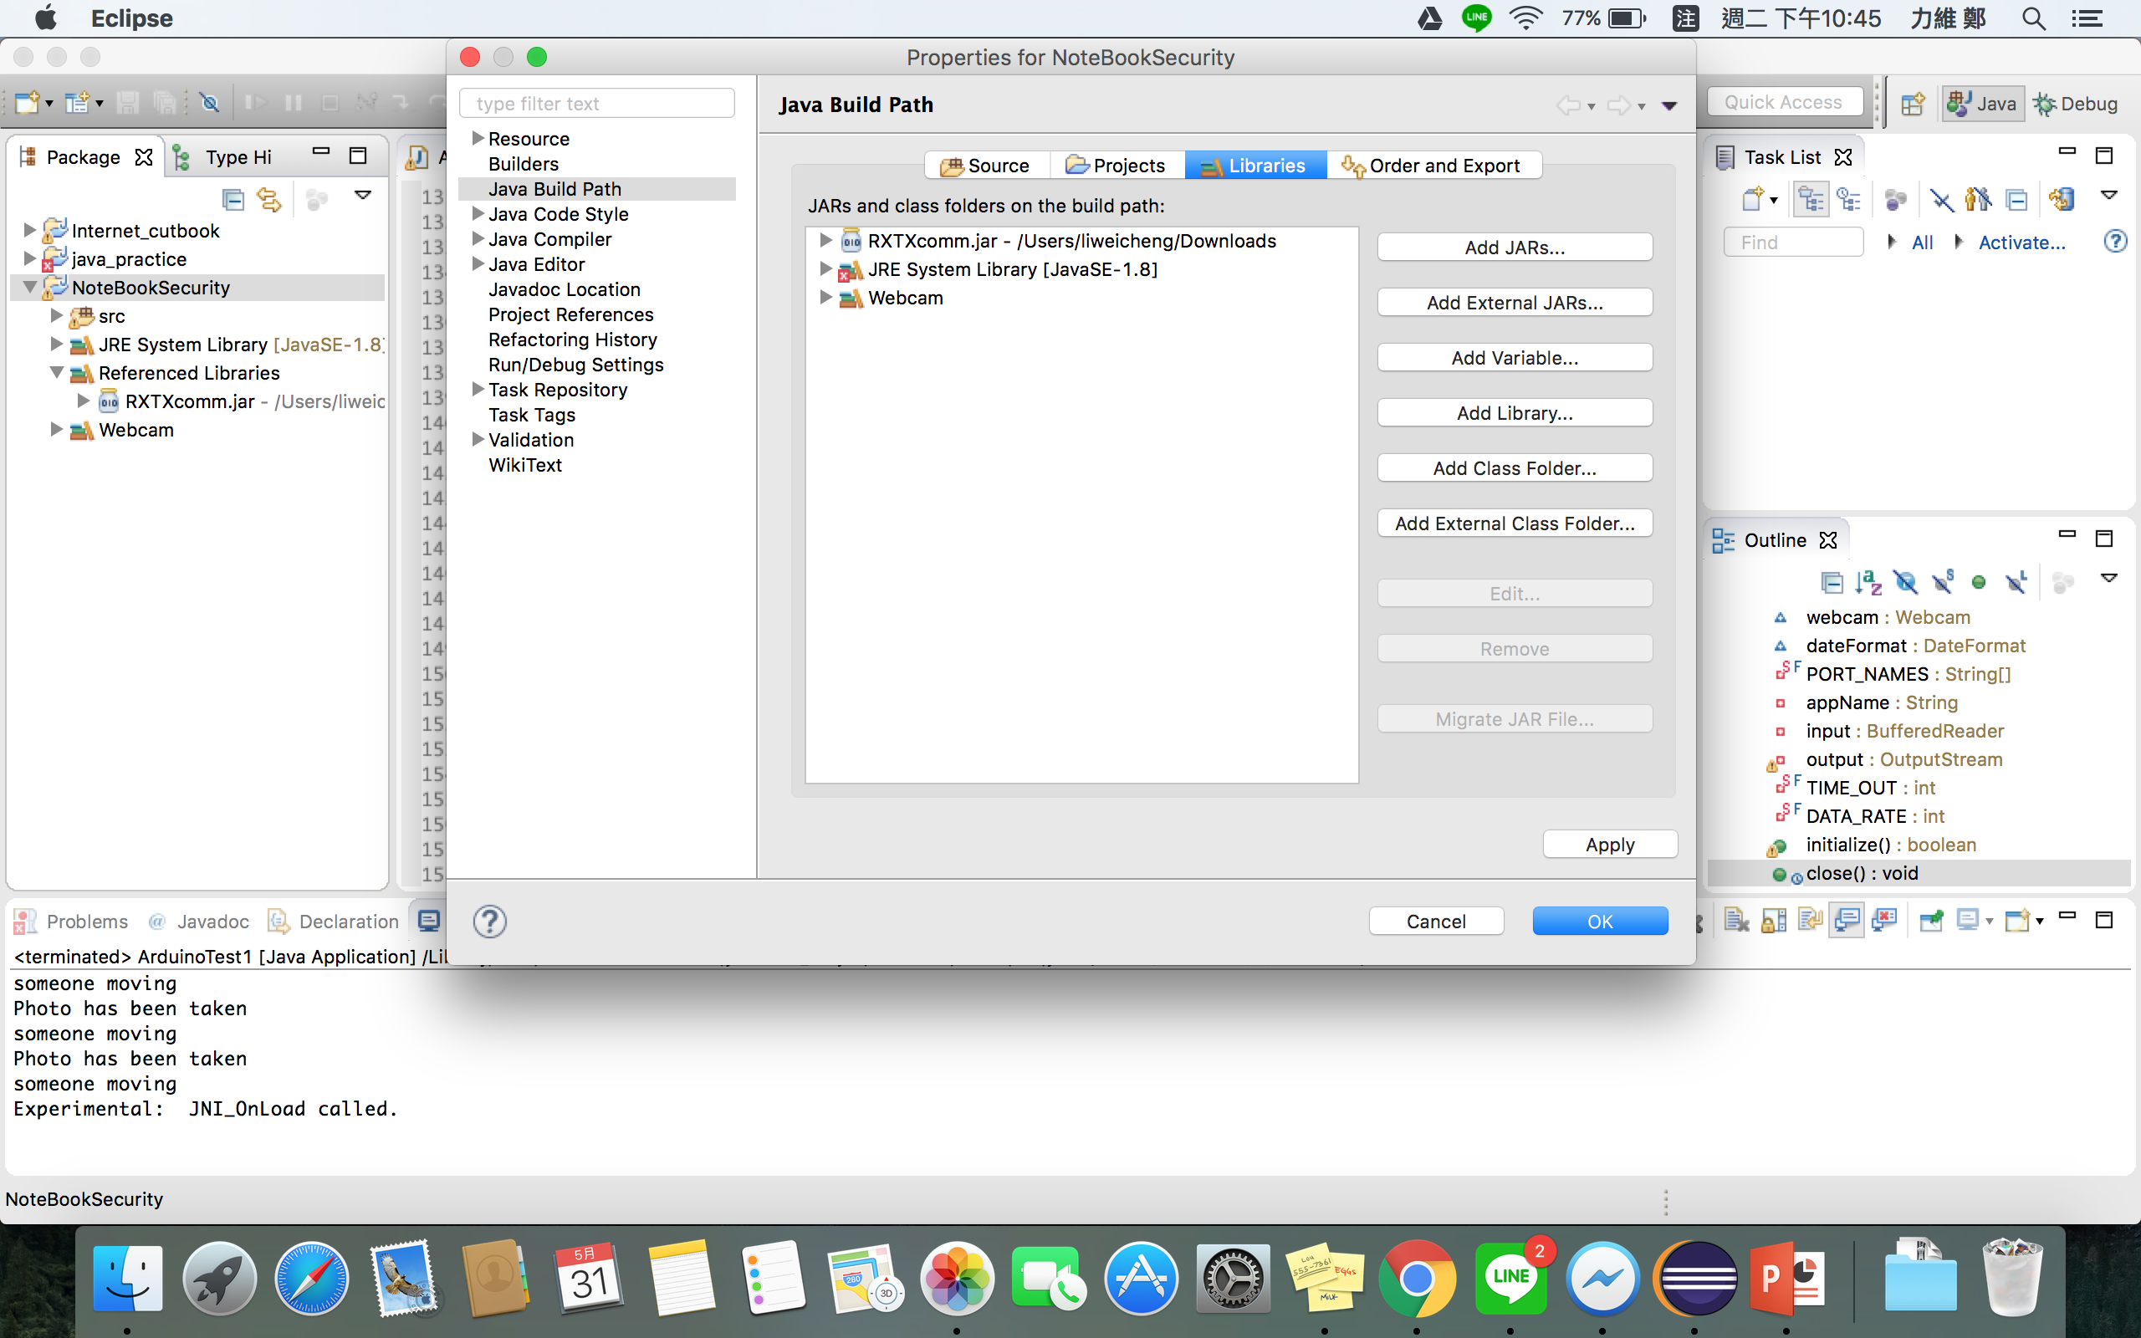
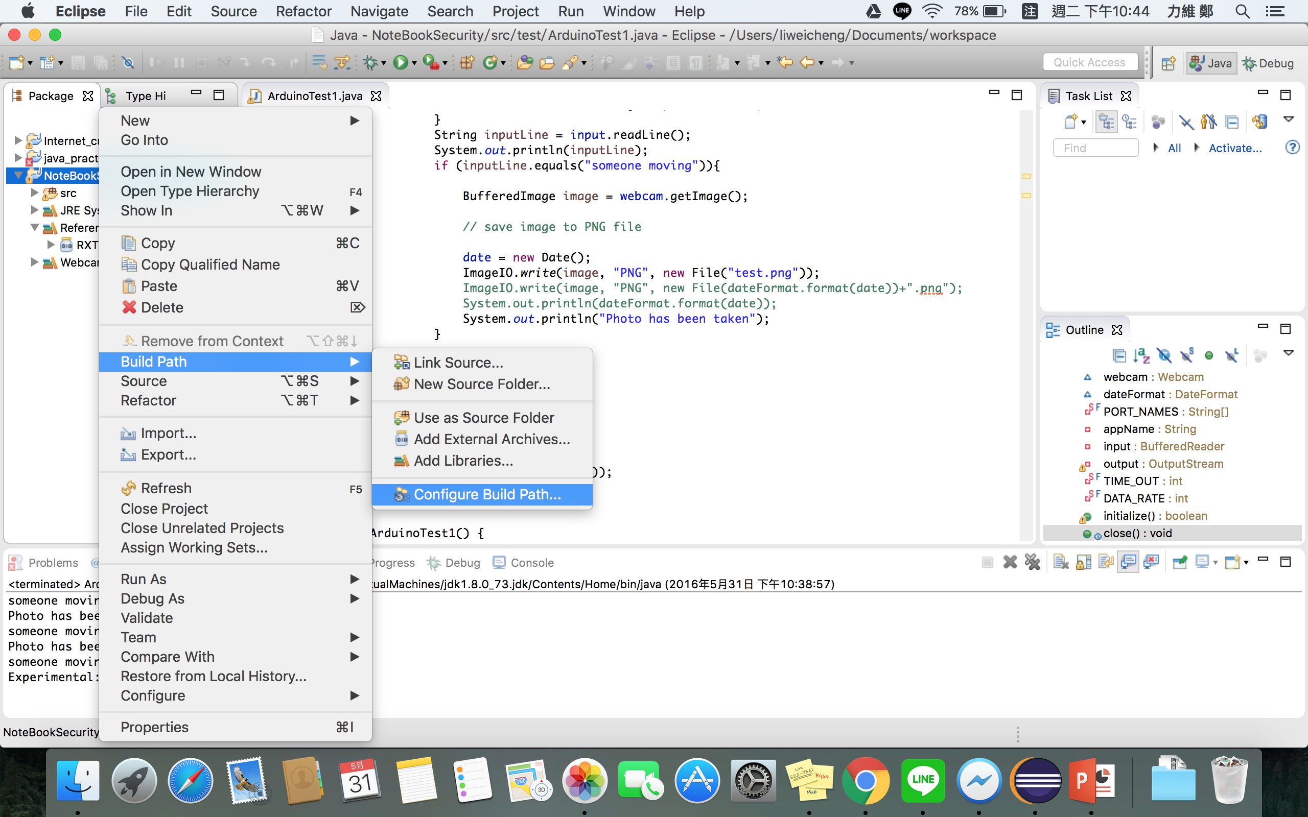
How to import *.jar

Slide 8
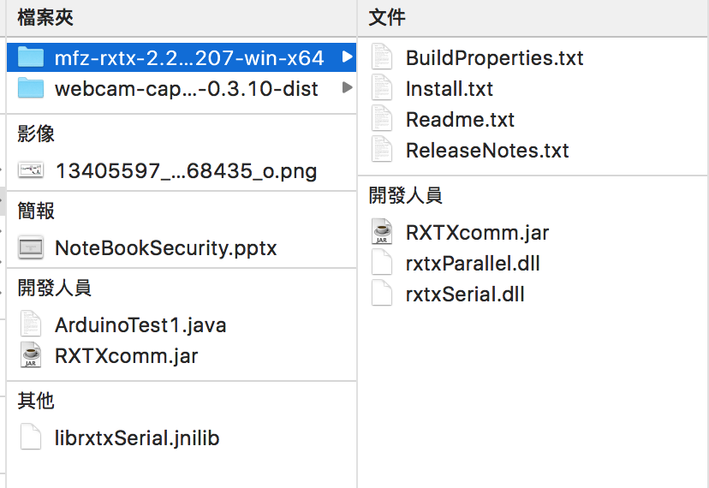
Read Arduino Serial Port Library
For Windows：
Put RXTXcomm.jar and rxtxSerial.dll in same folder.
For Mac：
Put RXTXcomm.jar and librxtxSerial.jnilib in same folder.
Import library (See the slides behind)
RXTXcomm.jar
http://fizzed.com/oss/rxtx-for-java

Slide 9
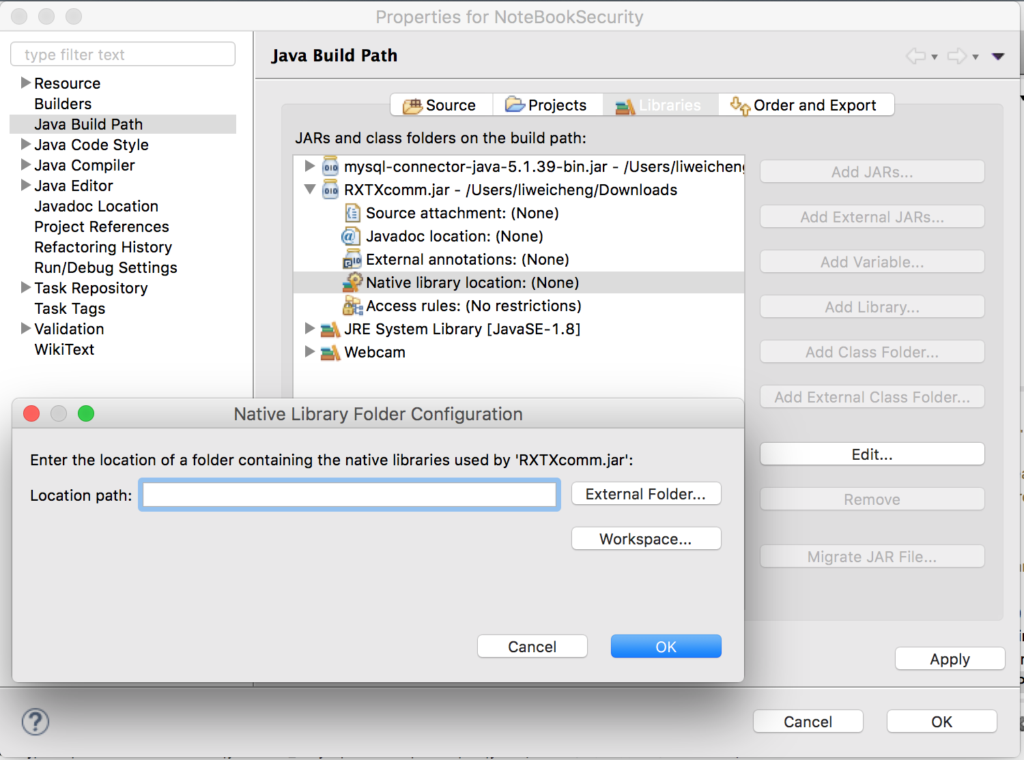
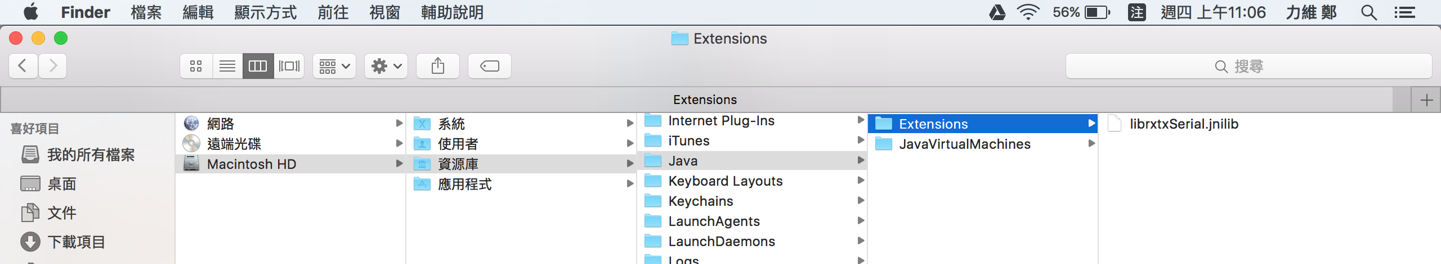
Read Arduino Serial Port Library
Because there is a additional file, importing this jar needs to add another library path.
For windos:
Right click in package explorer>Build path>PXTXcomm.jar>Native library location>Edit>External Folder>add the path of rxtxSerial.dll
For Mac: Add librxtxSerial.jnilib into Java> extensions

Slide 10
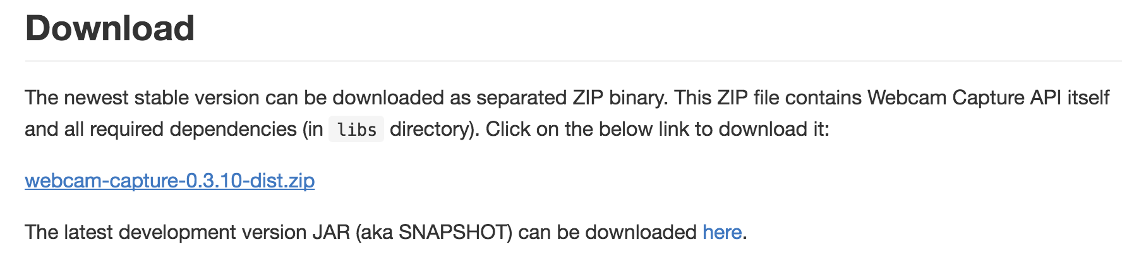
Webcam Library
https://github.com/sarxos/webcam-capture

Slide 11
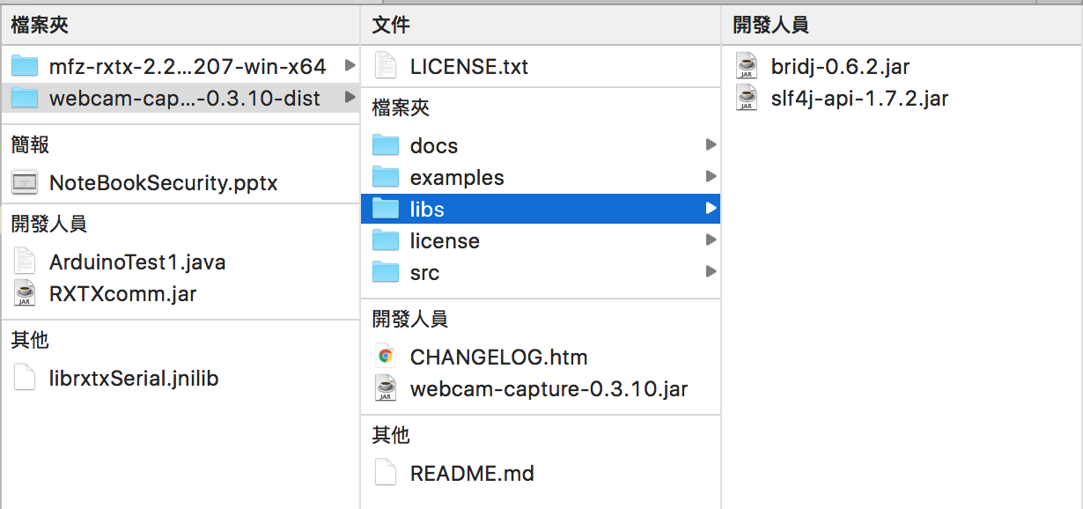
Webcam Library
Import library :
webcam-capture-0.3.10.jar
bridj-0.6.2.jar
slf4j-api-1.7.2.jar

Slide 12
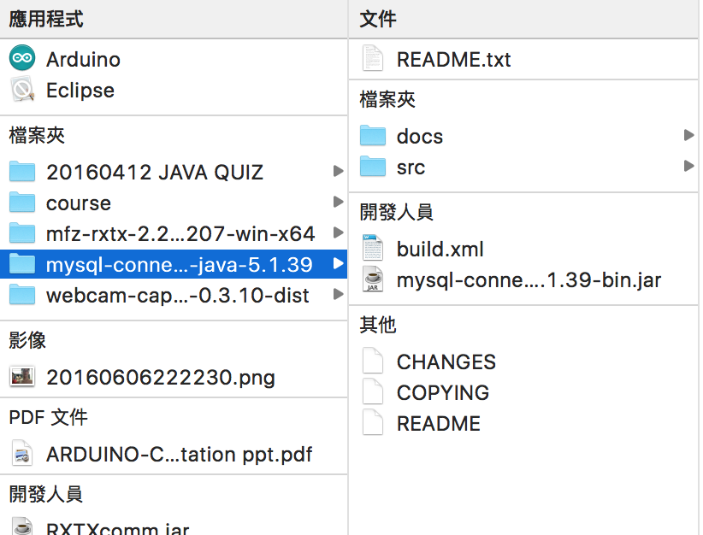
MySQL Library
Import library :
mysql-connector-java-5.1.39-bin.jar

Slide 13
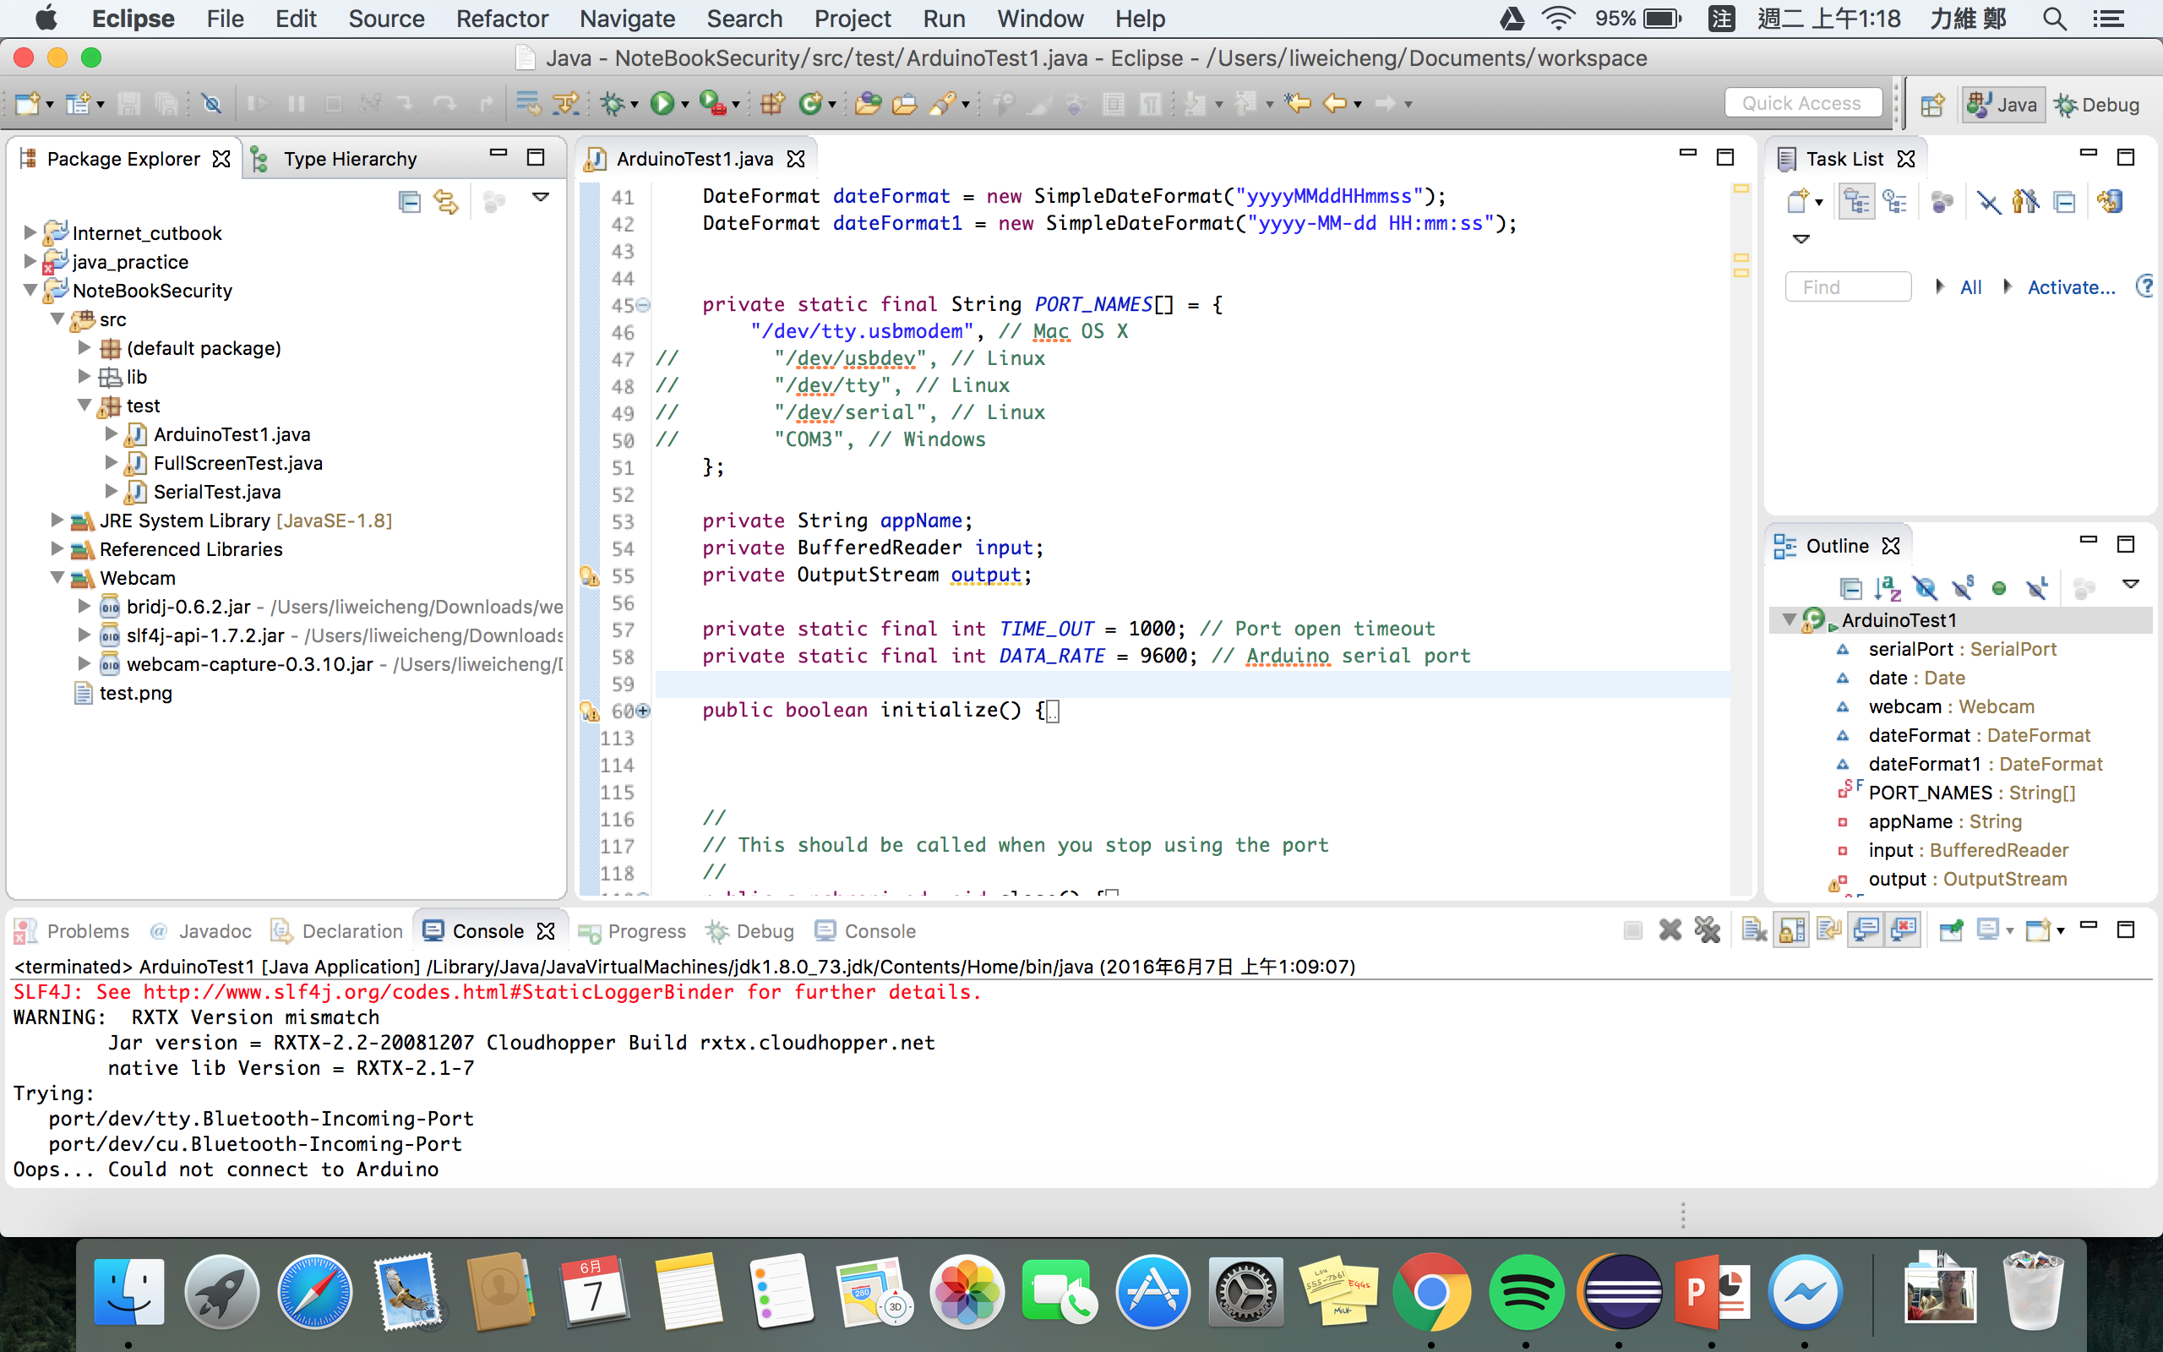
Execute the ArduinoTest1.java

Slide 14
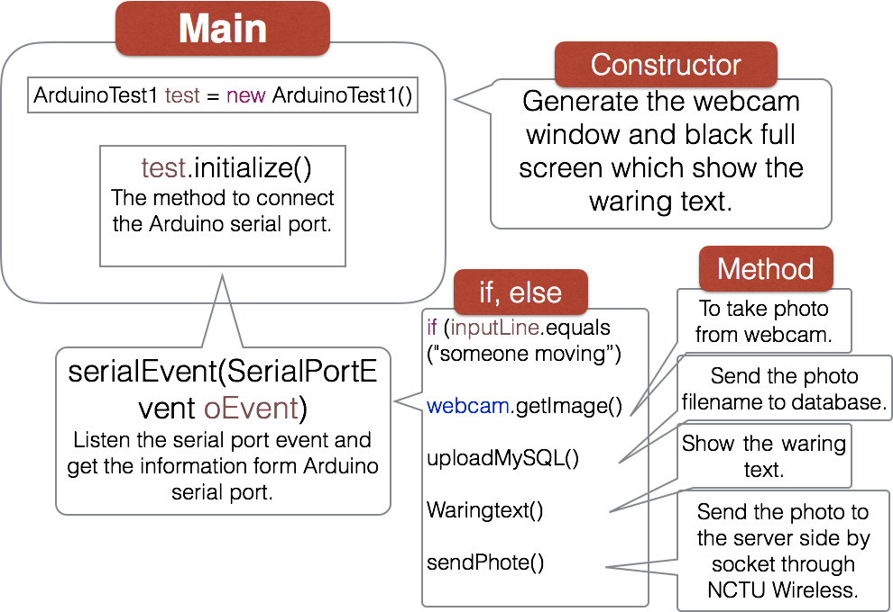
ArduinoTest1.java Code Structure

Slide 15
Server Side
Install Apache
WAMP server
Test Apache and phpmyadmin
Execute Server.java
(Inside the image folder.)

Slide 16
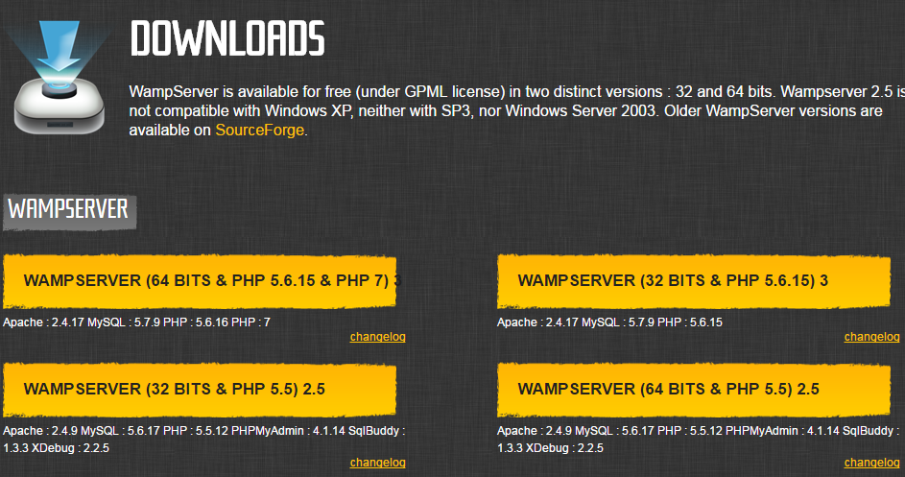

Install Apache
WAMP
http://www.wampserver.com/en/
WAMP: Windows, Apache, MySQL, and PHP", an application server platform.
If you see this icon, it means installed success

Slide 17
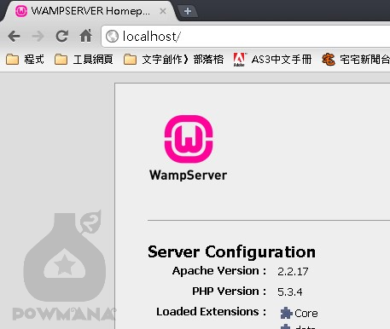
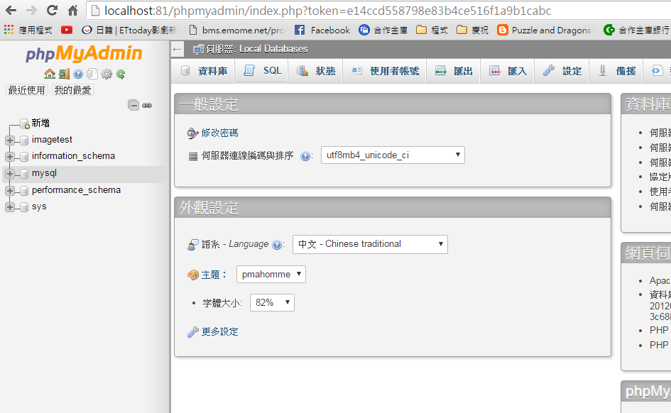
Test Apache and phpmyadmin
webserver
phpmyadmin

Slide 18
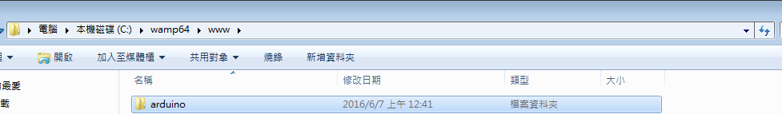
Webserver
C:\wamp64\www is the place what website need.
Inside “arduino” contains the website’s material.
It needs another folder inside “arduino”, named “image”. This folder is for storing images which are sent from client side to server side through Java program Server.java.

Slide 19
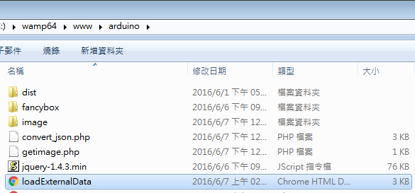
Webserver
“dist” and “fancybox” stores the jQuery API.
“image” folder stores the image.
“convert_json.php” is used to convert data from database to json.
“getimage.php” is used to convert image data to json.
“loadExternalData.html” is used to show the image as timeline.

Slide 20
Sever.java
public class Server {
public static void main (String[] args ) throws IOException {
int bytesRead;
int current = 0;
ServerSocket serverSocket = null;
serverSocket = new ServerSocket(13267);
while(true) {
Socket clientSocket = null;
clientSocket = serverSocket.accept();
System.out.println(”connecting");
InputStream in = clientSocket.getInputStream();
DataInputStream clientData = new DataInputStream(in);
String fileName = clientData.readUTF();
OutputStream output = new FileOutputStream(fileName);
long size = clientData.readLong();
byte[] buffer = new byte[1024];
while (size > 0 && (bytesRead = clientData.read(buffer,
0, (int)Math.min(buffer.length, size))) != -1) {
output.write(buffer, 0, bytesRead);
size -= bytesRead;
}output.close();
}
}
}
It is a basic server code for image transmission.
It needs to put in the image folder.

Slide 21
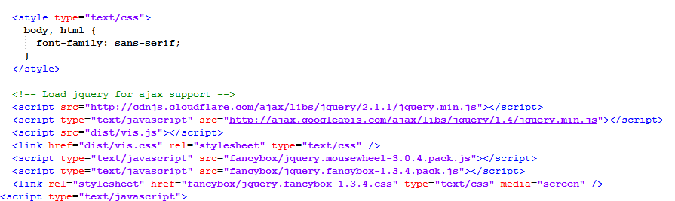
loadExternalData.html
Include the jQuery API

Slide 22
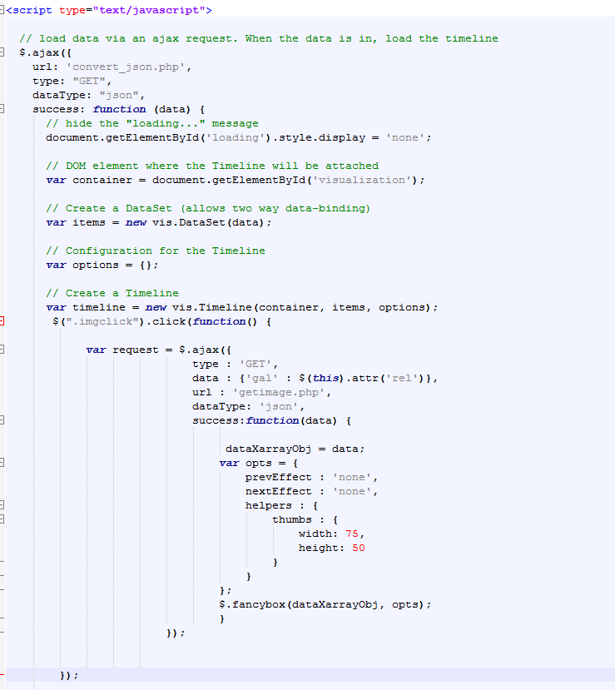
Show the timeline use the data from “getimage.php”

Slide 23
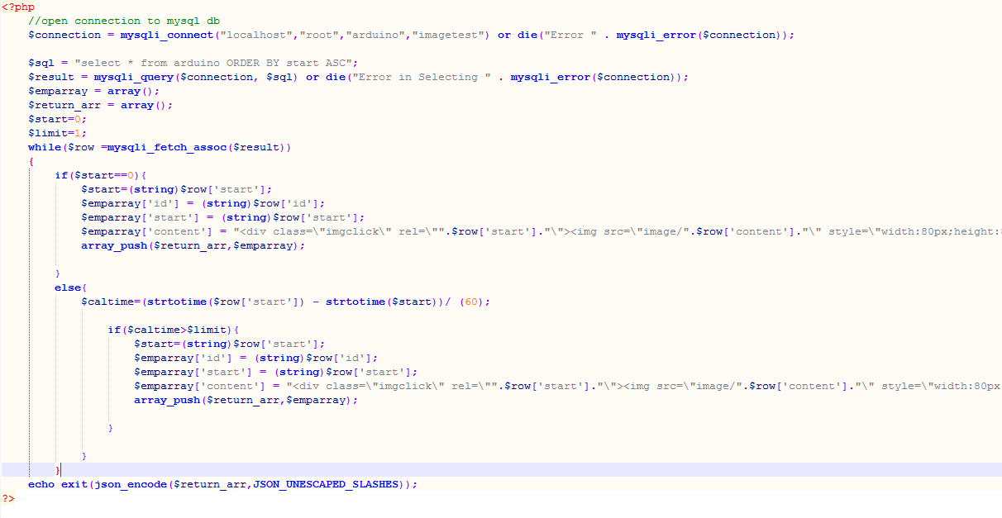
convert_json.php
Connect to database
Covert data from
database into json
Return json to loadExternalData.html

Slide 24
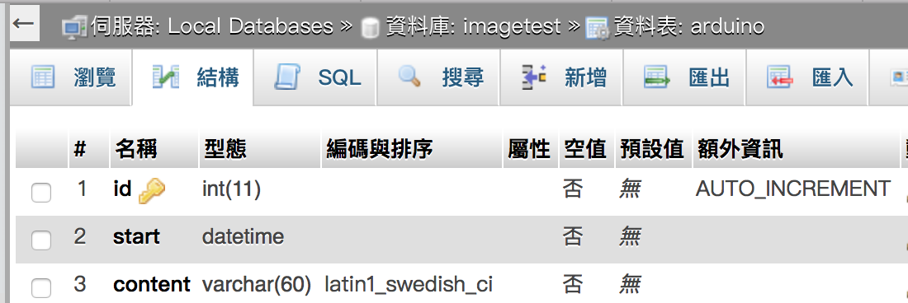
Database
You need a table in database.
Table stores three column: id, start, content.

Slide 25
ＴＨＥＥＮＤ

